Slide 1


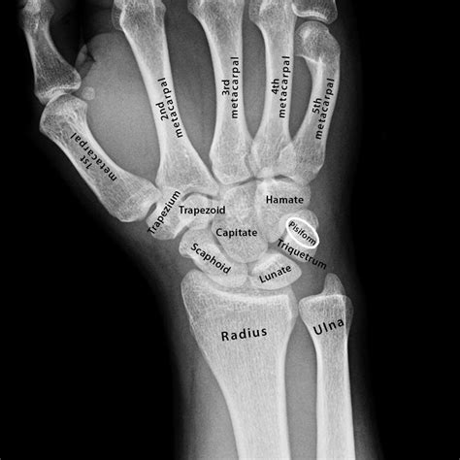
LECTURE#4 (20/09/2024)
X RAYS OF HAND
Fsc Medical Imaging Technology
H/Dr. Ayesha Rauf
www.medmedals.com

Slide 2
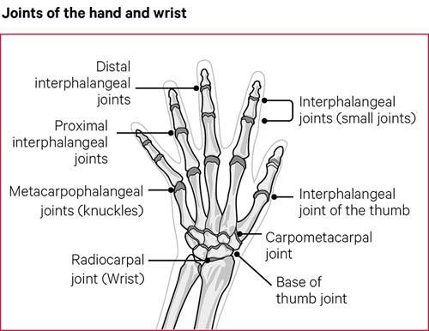

Slide 3
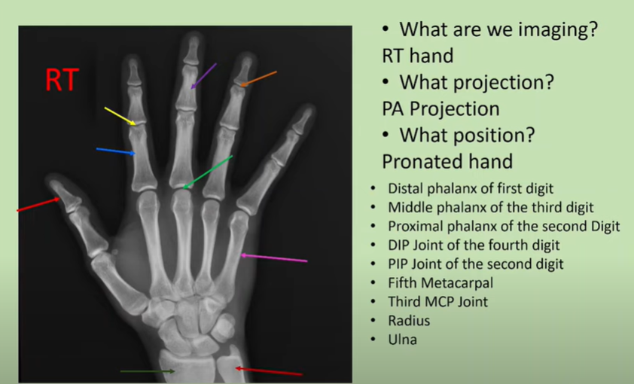

Slide 4
STANDARD VIEWS (5)
a. Posteroanterior (PA) View
b. Oblique View (External Rotation)
c. Lateral View
Optional or Special Views:
  Ball-Catcher’s View (Norgaard Method): Used to evaluate early signs of rheumatoid arthritis in both hands, where the patient cups their hands as if to catch a ball.

Slide 5
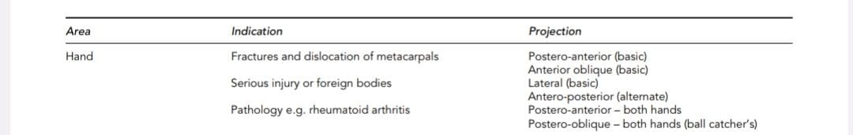

Slide 6
1. Posteroanterior (PA) View
  Description: The hand is placed flat, palm-down (pronated) on the X-ray detector.
  Purpose: Provides a general overview of the bones, joints, and soft tissues. It is useful for detecting fractures, joint spacing, and signs of arthritis.
2. Oblique View
  Description: The hand is externally rotated 45 degrees from the PA position, resting on the edge of the palm.
  Purpose: Helps in detecting fractures, particularly in the metacarpals and phalanges, that may not be visible in the PA view.
3. Lateral View
  Description: The hand is positioned with the ulnar side (pinky side) down, either with the fingers stacked or fanned out.
  Purpose: Used to assess bone alignment, displacement of fractures, soft tissue swelling, and foreign bodies. It is especially useful for evaluating fractures in lateral projection.

Slide 7
4. Norgaard View (Ball-Catcher’s View)
  Description: Both hands are positioned in a semi-supinated "cupping" position, like catching a ball.
  Purpose: Designed to assess early signs of rheumatoid arthritis, especially in the metacarpophalangeal (MCP) joints. It is used to detect joint erosion and narrowing.

Slide 8
LECTURE#4 (20/09/2024)
PA VIEW
Fsc Medical Imaging Technology
H/Dr. Ayesha Rauf
www.medmedals.com

Slide 9
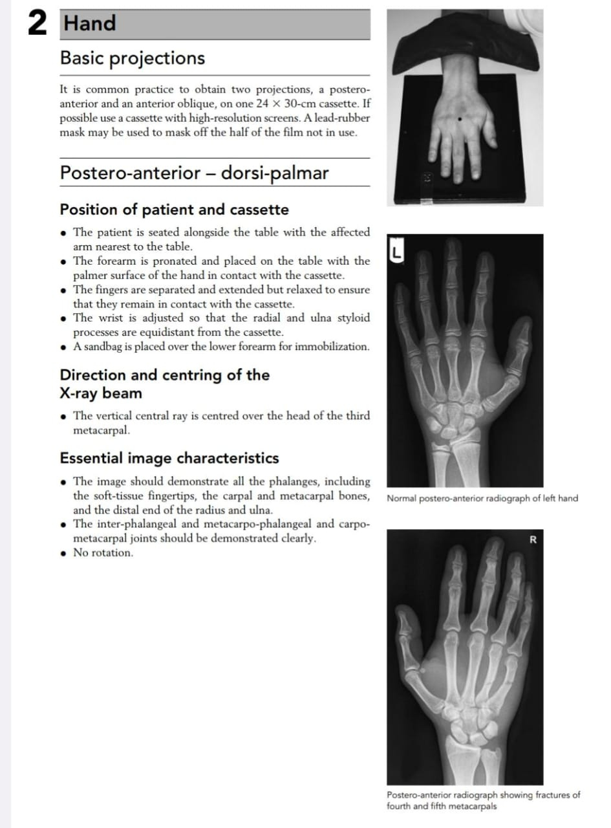

Slide 10
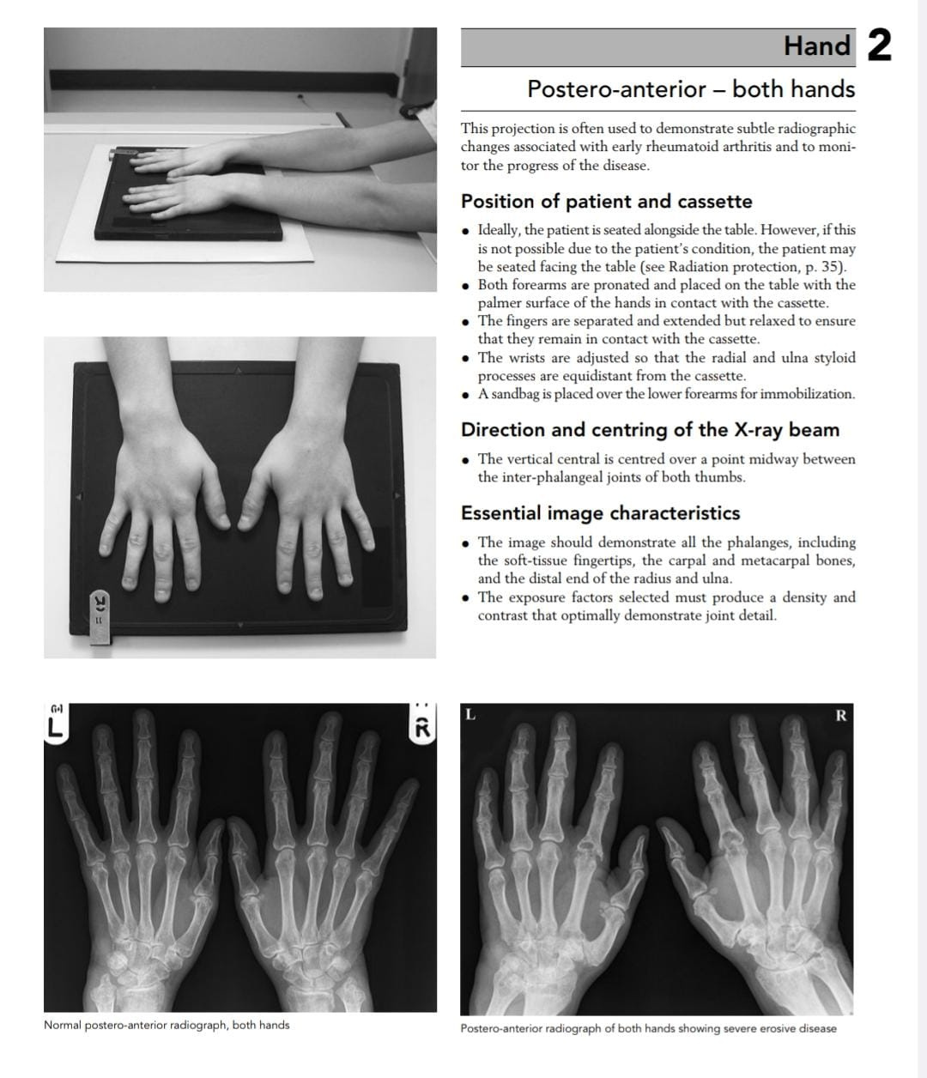

Slide 11
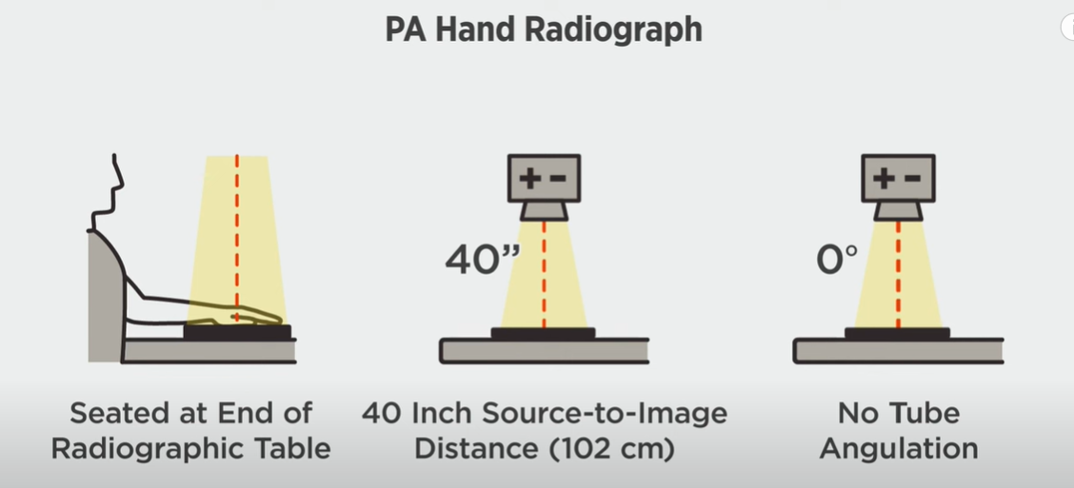

Slide 12
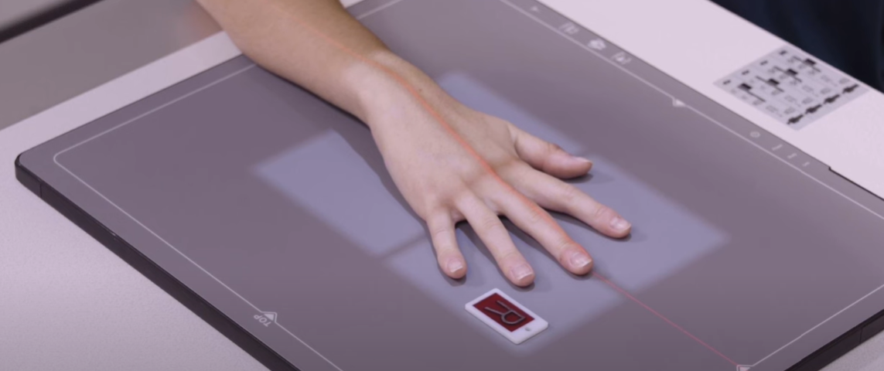
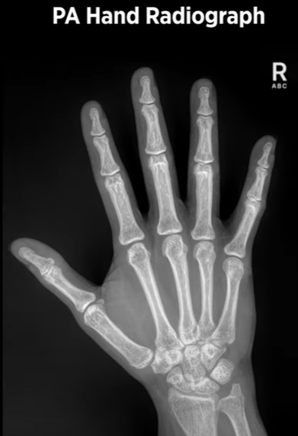

Slide 13
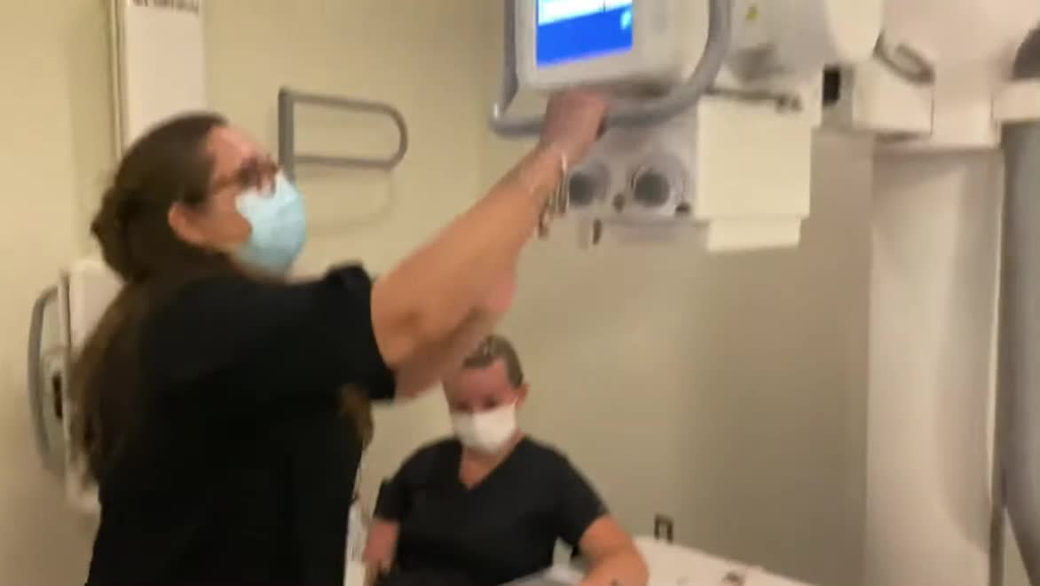

Slide 14
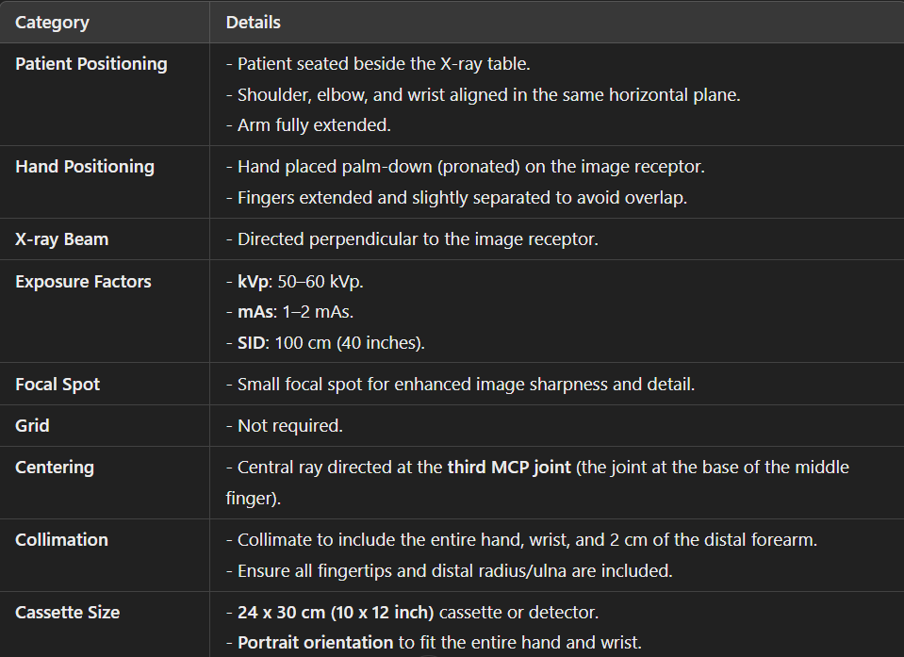

Slide 15
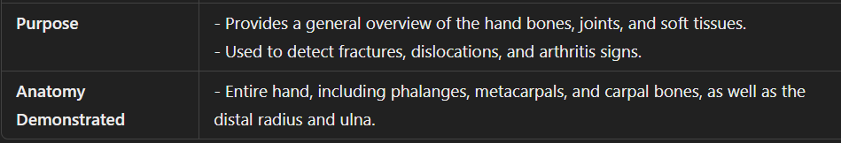
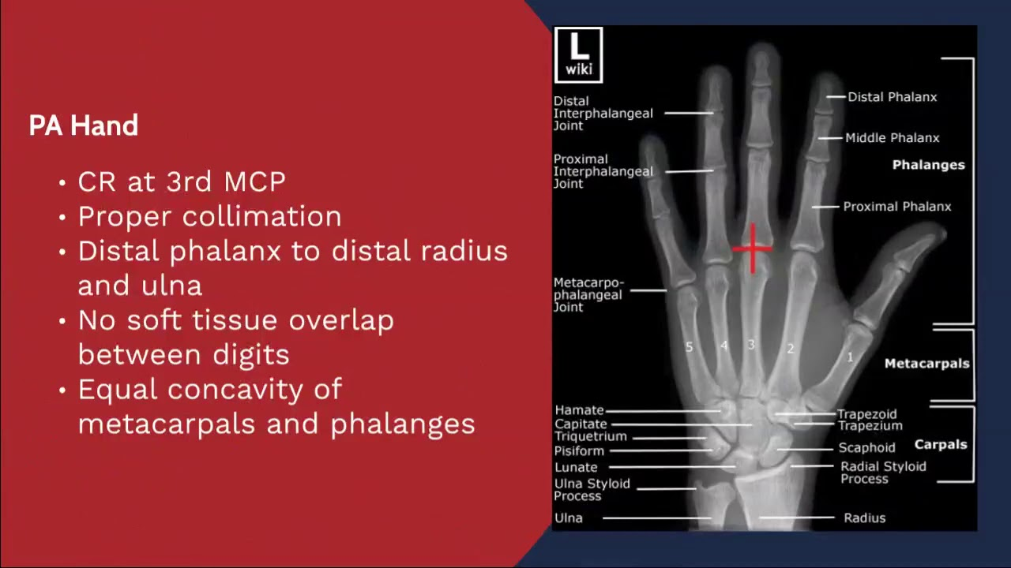

Slide 16
LECTURE#4 (20/09/2024)
AP OBLIQUE VIEW
Fsc Medical Imaging Technology
H/Dr. Ayesha Rauf
www.medmedals.com

Slide 17
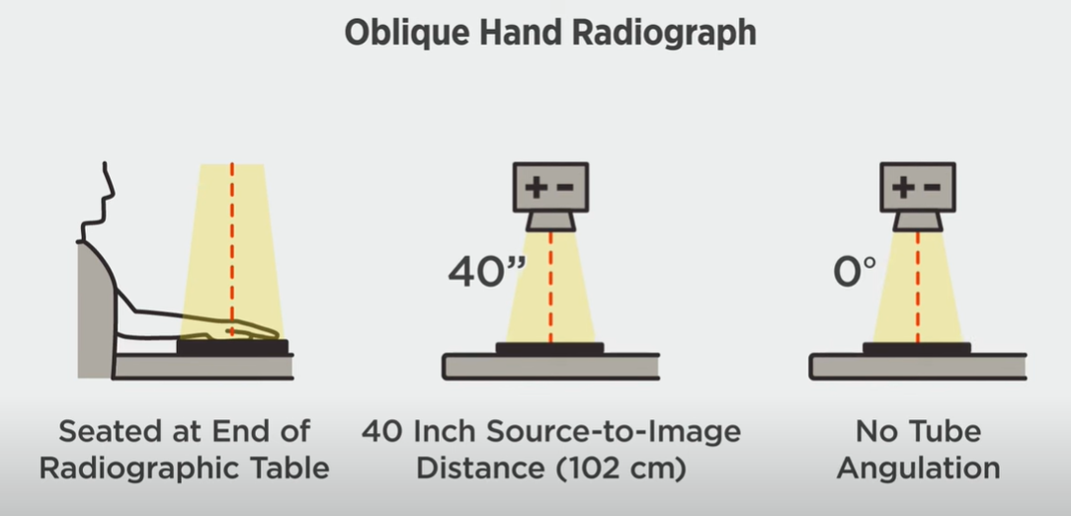

Slide 18
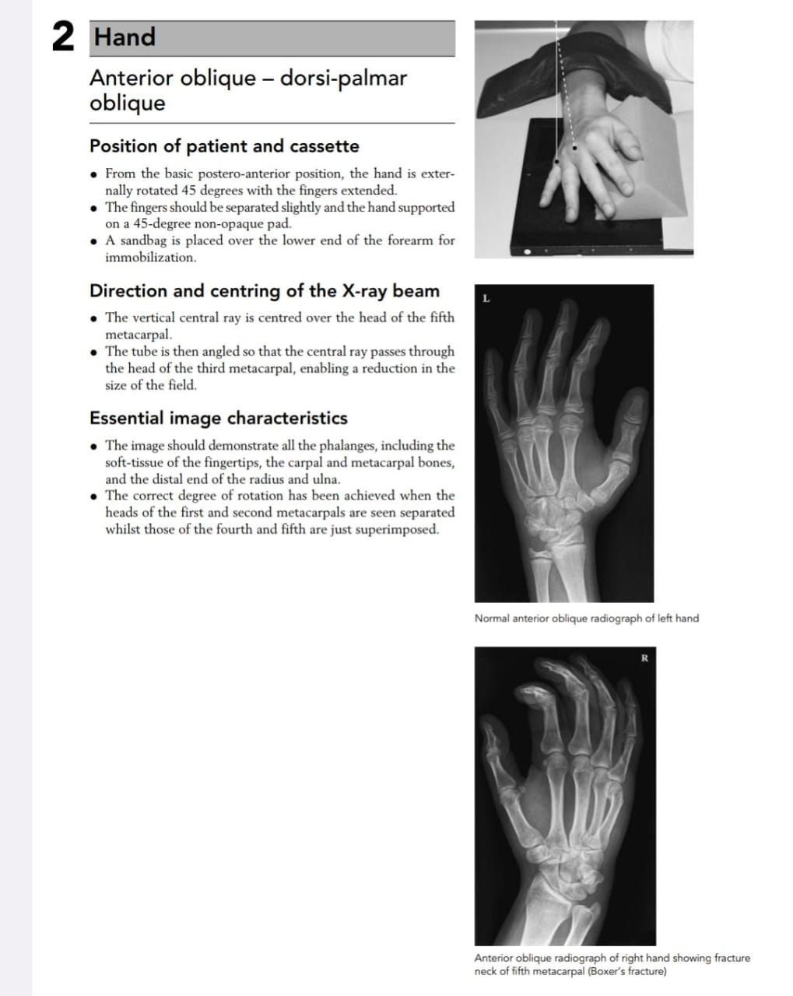

Slide 19
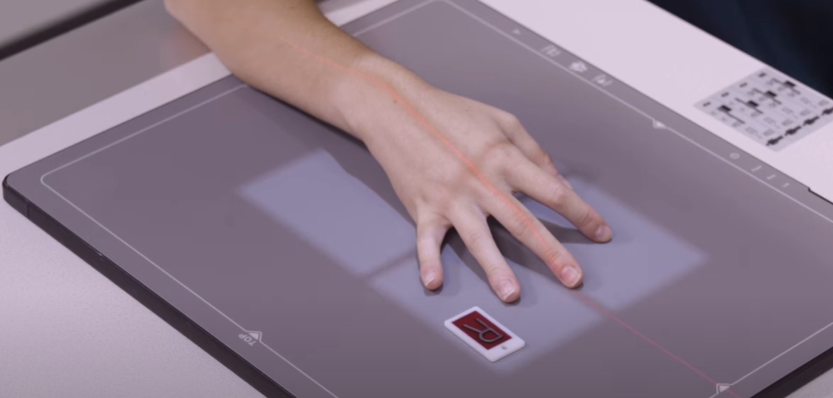
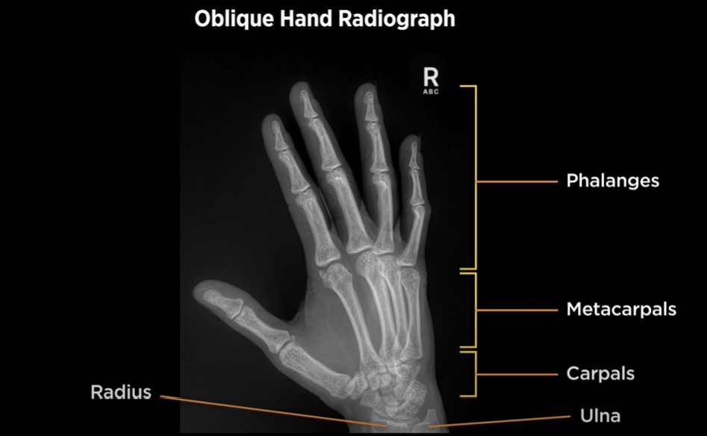

Slide 20
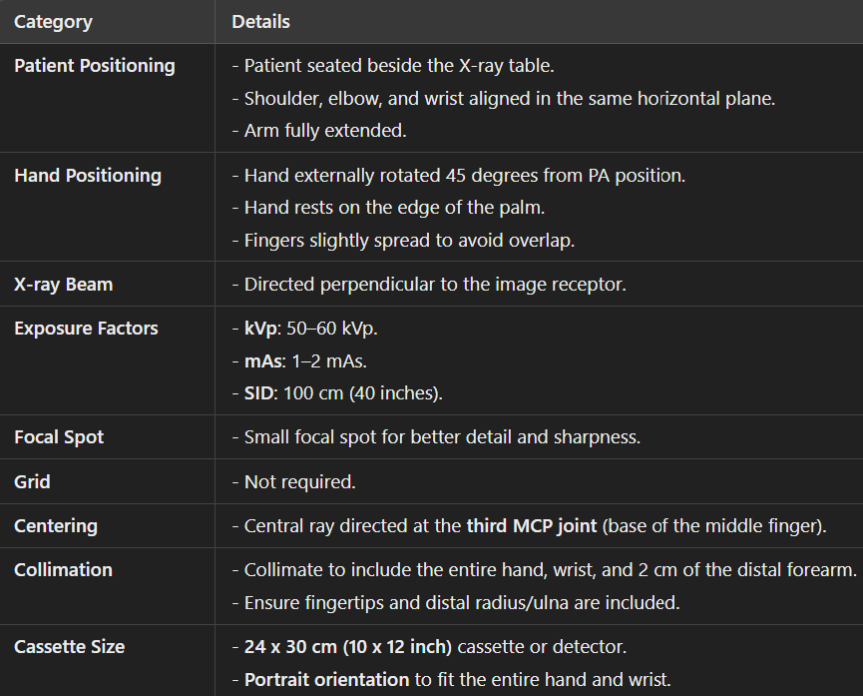

Slide 21
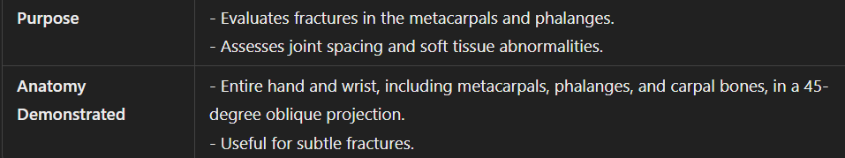
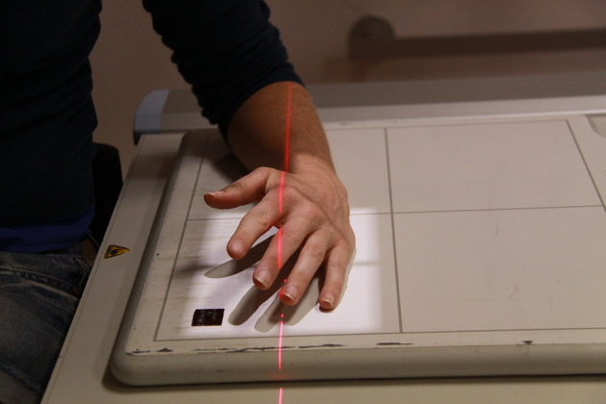
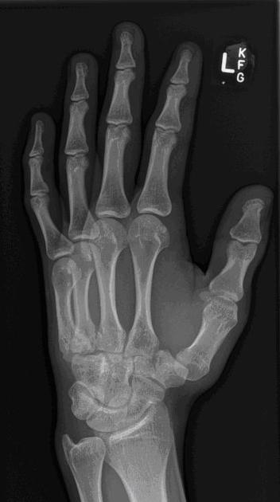
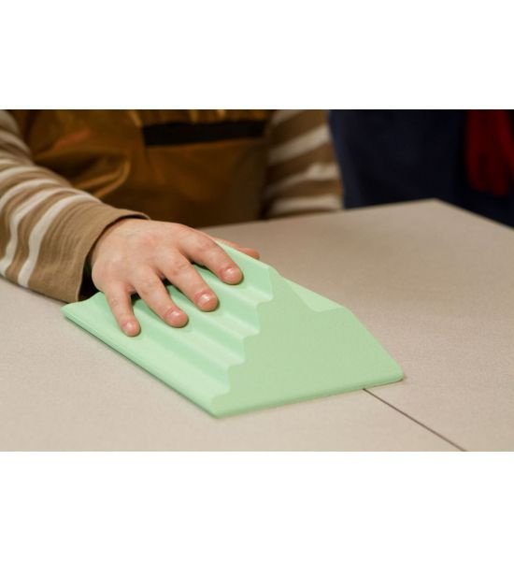

Slide 22
LECTURE#4 (20/09/2024)
LATERALVIEW
Fsc Medical Imaging Technology
H/Dr. Ayesha Rauf
www.medmedals.com

Slide 23
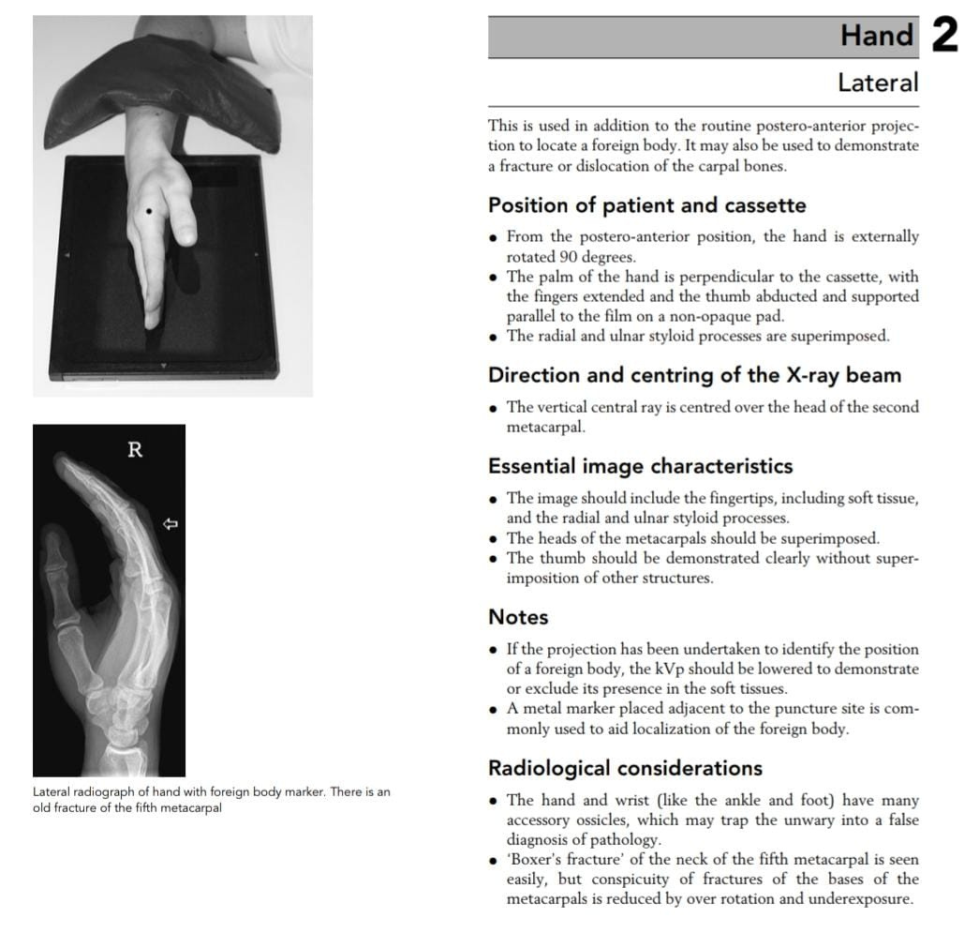

Slide 24
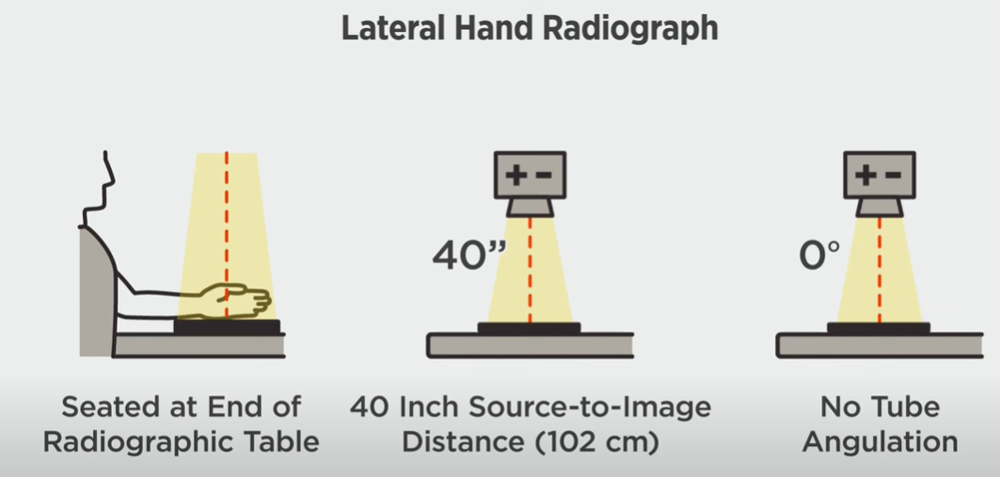

Slide 25
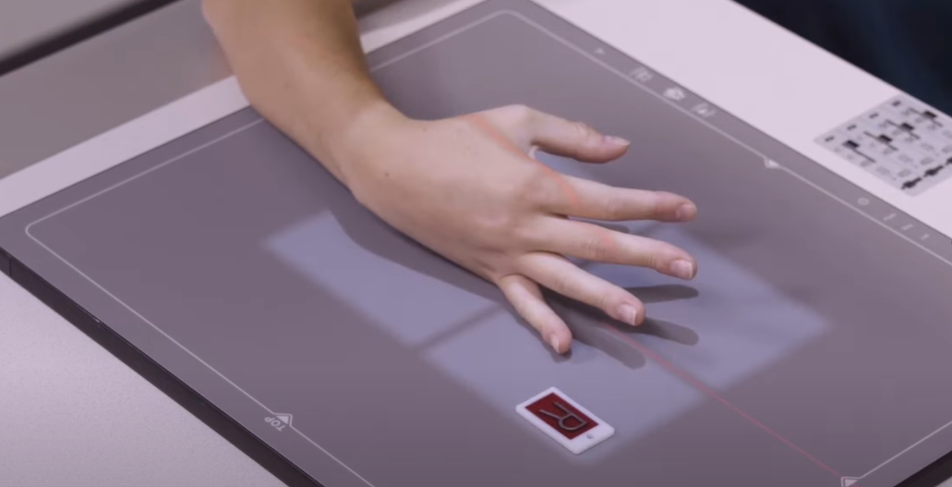
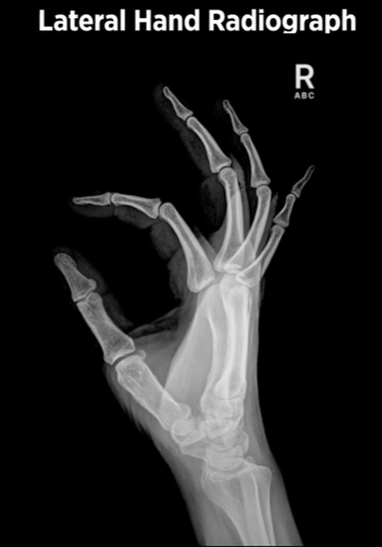

Slide 26
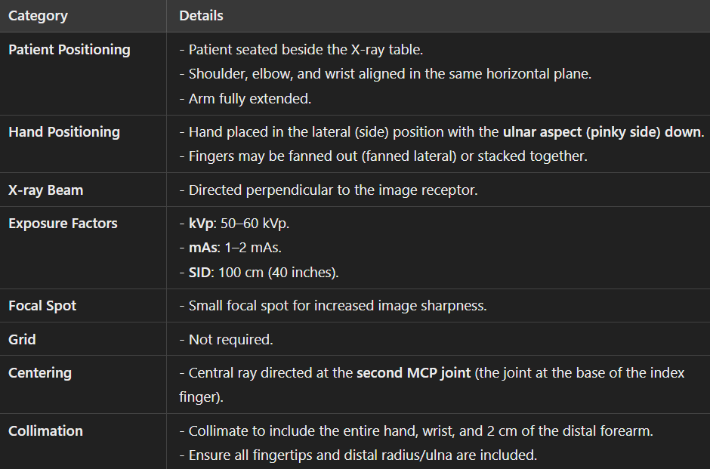

Slide 27
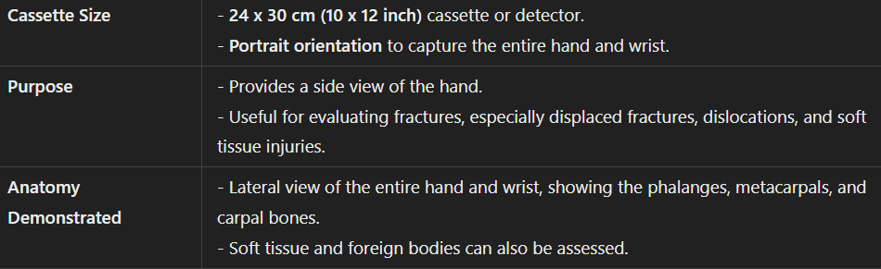

Slide 28
LECTURE#4 (20/09/2024)
BALL-CATCHER’S VIEW (NORGAARD METHOD)
AP OBLIQUE PROJECTION
MEDIAL ROTATION
Fsc Medical Imaging Technology
H/Dr. Ayesha Rauf
www.medmedals.com

Slide 29
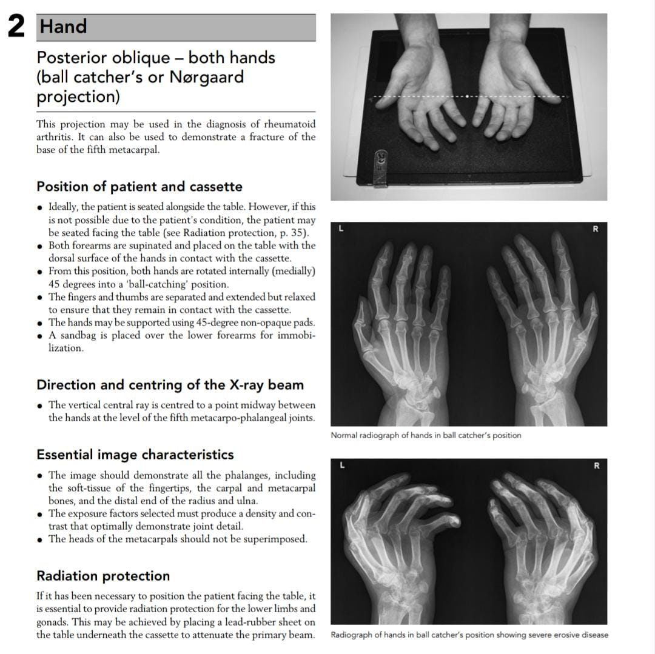

Slide 30
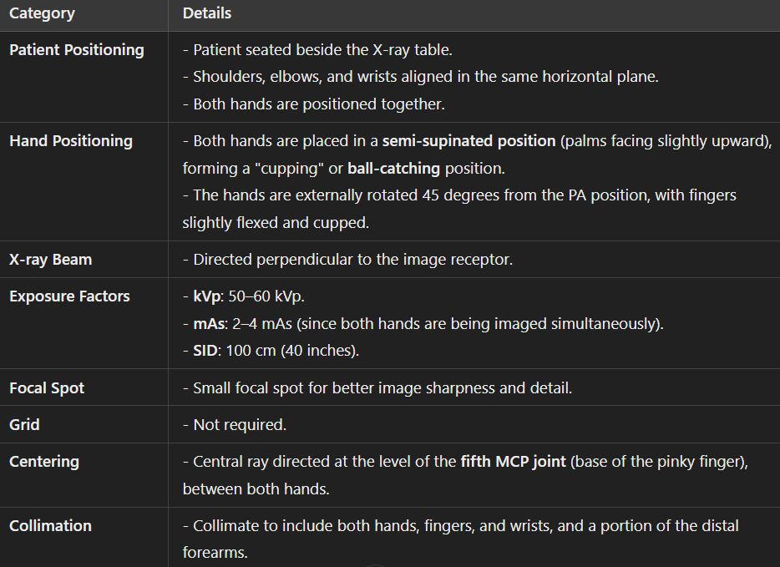

Slide 31
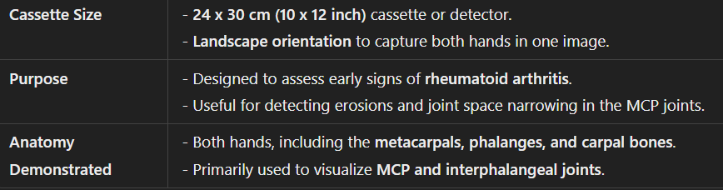

Slide 32
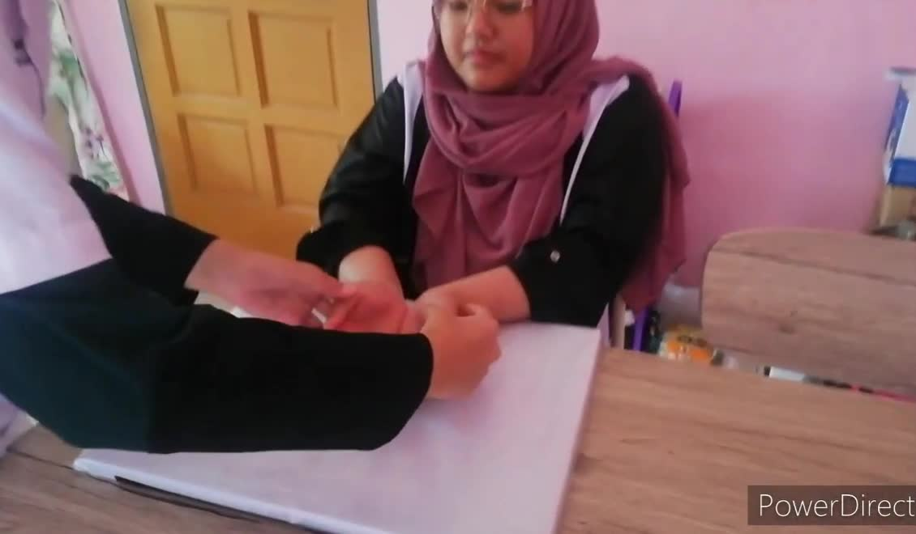

Slide 33
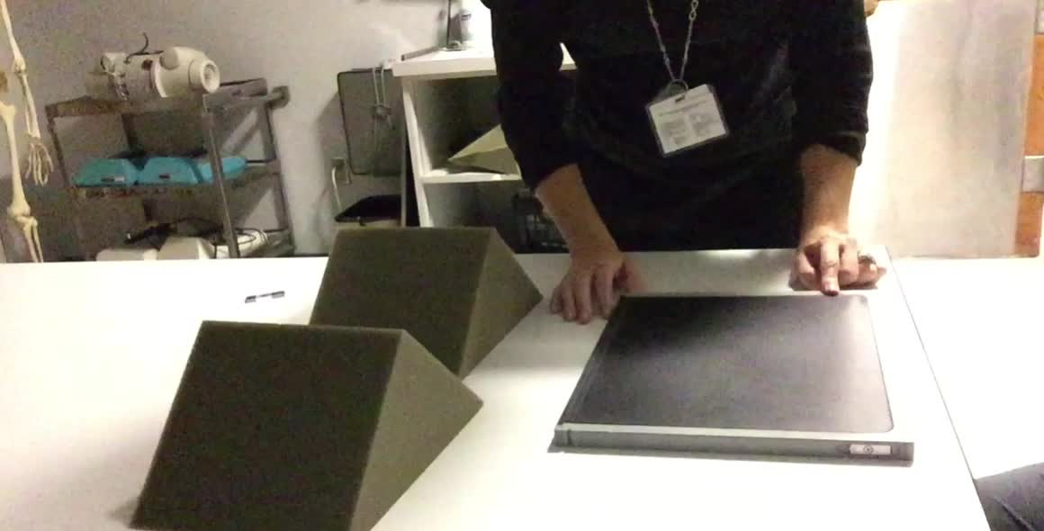

Slide 34
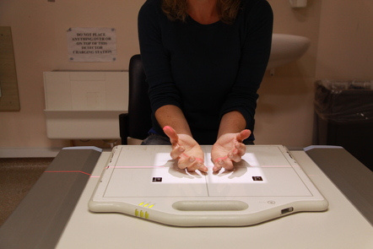
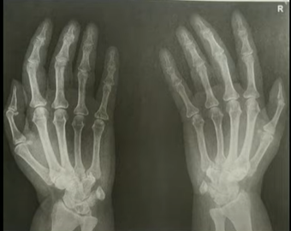

Slide 35
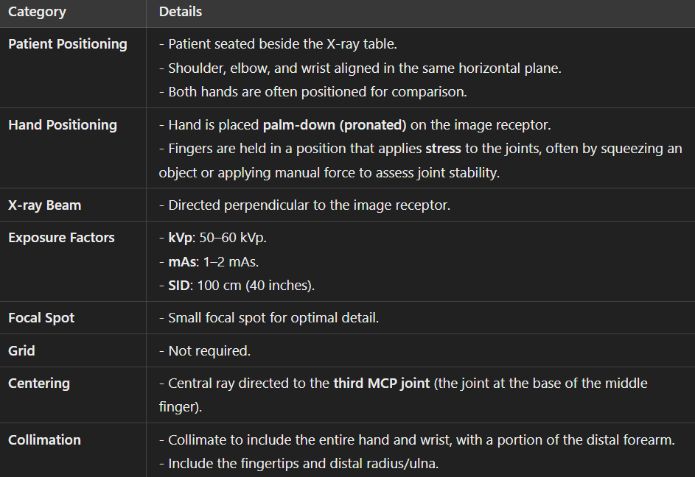

Slide 36
