Slide 1

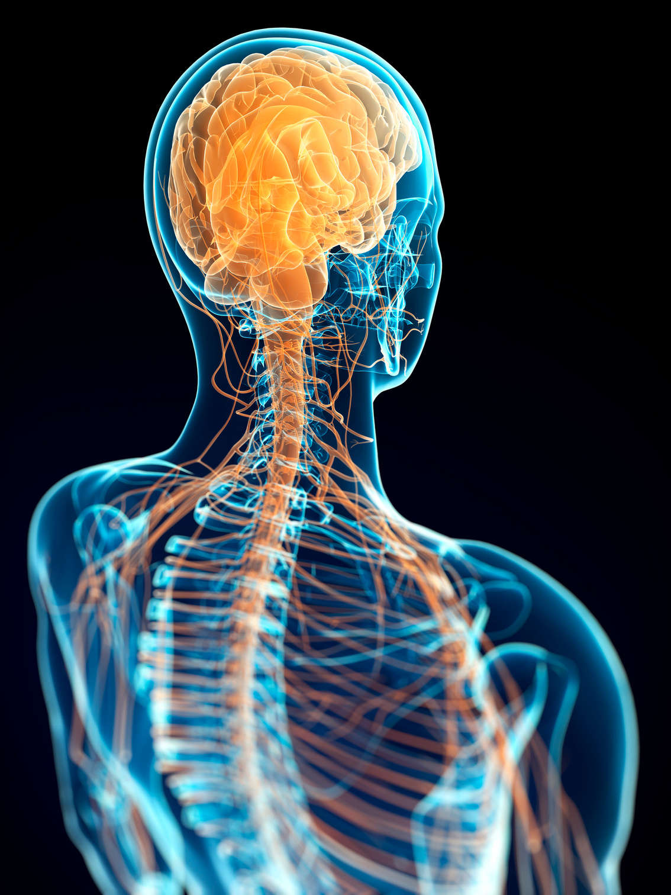

LECTURE #3 (25/9/2024)
ORGANIZATION OF THE NERVOUS SYSTEM & STRUCTURE OF NEURON AND NERVE
BS MLT-II
H/DR. AYESHA RAUF
www.medmedals.com/bs-mlt-2

Slide 2
INTRODUCTION TO THE NERVOUS SYSTEM
  Definition: The nervous system is a complex network responsible for coordinating bodily activities and responding to internal and external stimuli.
  Main Functions: Sensory input, integration, motor output.

Slide 3
  The nervous system is divided into CNS and PNS, each with specific roles in sensory and motor functions.
  Neurons and nerves are critical for transmitting signals throughout the body, coordinating various functions.

Slide 4
INTRODUCTION TO THE NERVOUS SYSTEM
  Central Nervous System (CNS): Brain and spinal cord.
  Functions: Integration and processing of information.
  Peripheral Nervous System (PNS): All neural structures outside the CNS.
  Divided into:
    Somatic Nervous System: Voluntary control over skeletal muscles.
    Autonomic Nervous System (ANS): Involuntary control over organs and glands.
      Sympathetic Division: 'Fight or flight' responses.
      Parasympathetic Division: 'Rest and digest' responses.

Slide 5
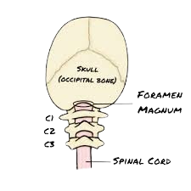
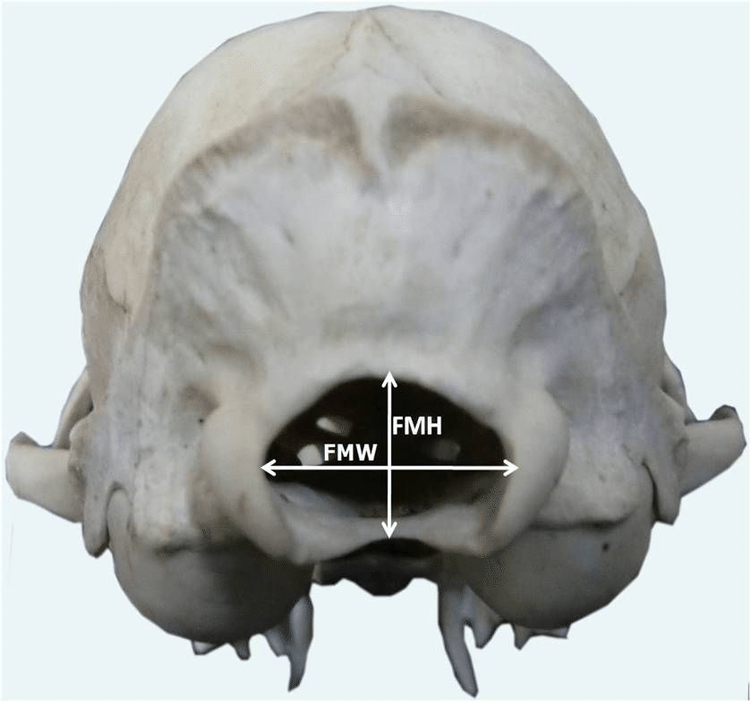

Slide 6
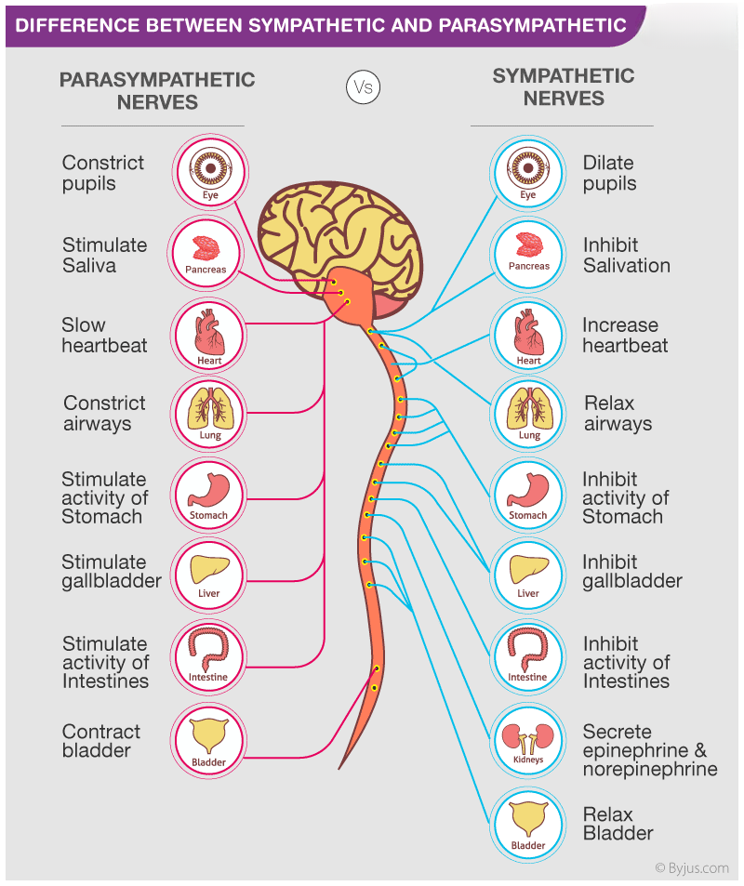

Slide 7
CENTRAL NERVOUS SYSTEM (CNS)
  Brain:
  Major regions: Cerebrum, cerebellum, brainstem.
  Functions: Consciousness, motor control, sensory processing, and regulation of homeostasis.
  Spinal Cord:
Role in relaying information between the brain and the body.

Slide 8
PERIPHERAL NERVOUS SYSTEM (PNS)
  Nerve Types: Sensory (afferent), motor (efferent), mixed nerves.
  Cranial and Spinal Nerves:
  12 pairs of cranial nerves.
  31 pairs of spinal nerves.
Role: Communication between the CNS and limbs/organs.

Slide 9
STRUCTURE OF A NEURON
Basic Parts:
  Cell Body (Soma): Contains the nucleus.
  Dendrites: Receive incoming signals.
  Axon: Conducts electrical impulses away from the cell body.
  Myelin Sheath: Insulating layer that speeds up signal transmission.
  Axon Terminals: Release neurotransmitters to communicate with other neurons.

Slide 10
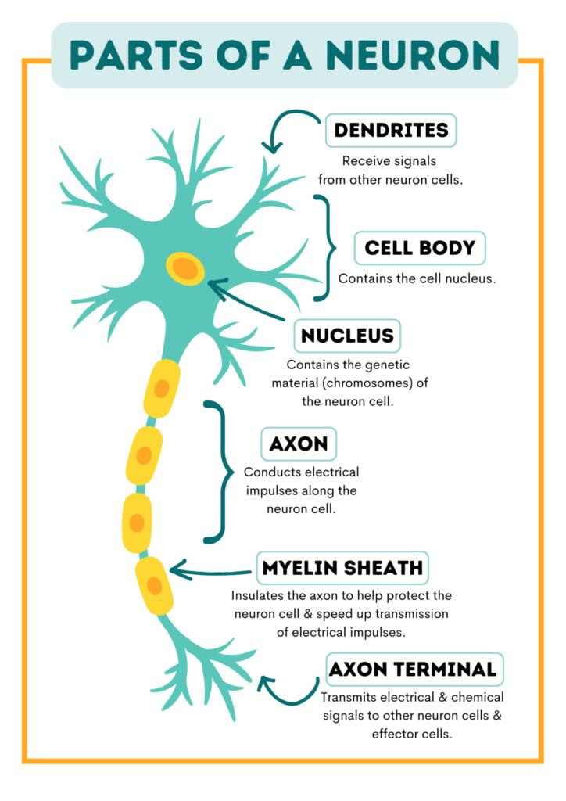

Slide 11
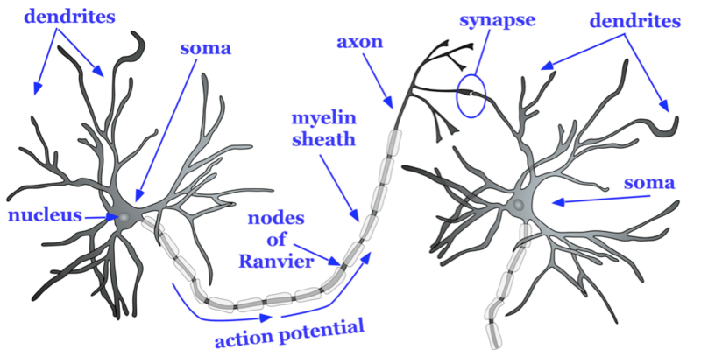

Slide 12
TYPES OF NEURONS
  Sensory Neurons (afferent neurons): Transmit signals from sensory receptors to CNS.
  Motor Neurons (Efferent NEURON): Carry instructions from CNS to muscles and glands. (LONG AXON, DENDROID SHORT)
  Interneurons: Connect neurons within the CNS for integration.

Slide 13
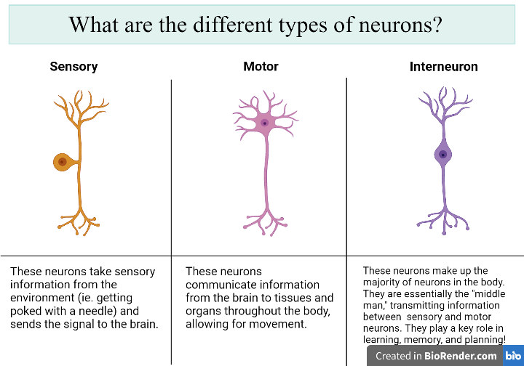

Slide 14
NERVE STRUCTURE
  Nerve Composition: Bundle of axons.
  Connective Tissue Layers:
  Epineurium: Outer layer covering the entire nerve.
  Perineurium: Surrounds bundles of axons (fascicles).
  Endoneurium: Encases individual axons.

Slide 15
SYNAPSE AND NEUROTRANSMISSION
  Synapse: Junction between neurons.
  Process:
  Electrical signal (action potential) reaches the axon terminal.
  Neurotransmitters are released.
  Neurotransmitters bind to receptors on the next neuron, causing depolarization or inhibition.

Slide 16
FUNCTIONAL ORGANIZATION OF THE NERVOUS SYSTEM
  Reflex Arc: Simple neural pathway.
    Components: Sensory receptor, sensory neuron, interneuron, motor neuron, effector.
  Autonomic Pathways:
    Involve two neurons between CNS and the effector (preganglionic and postganglionic neurons).

